Slide 1
Economic Effects of COVID-19 and Fiscal Policy Responses

Slide 2
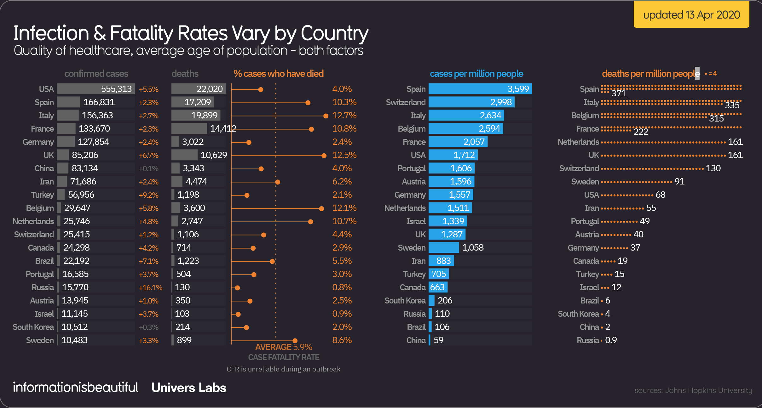

Slide 3
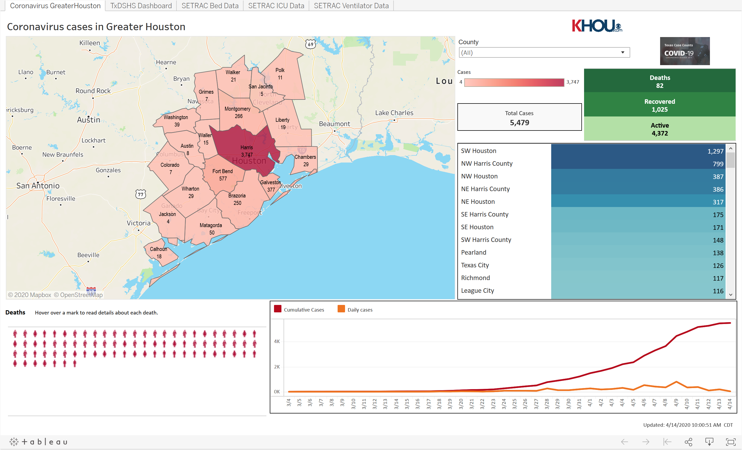

Slide 4
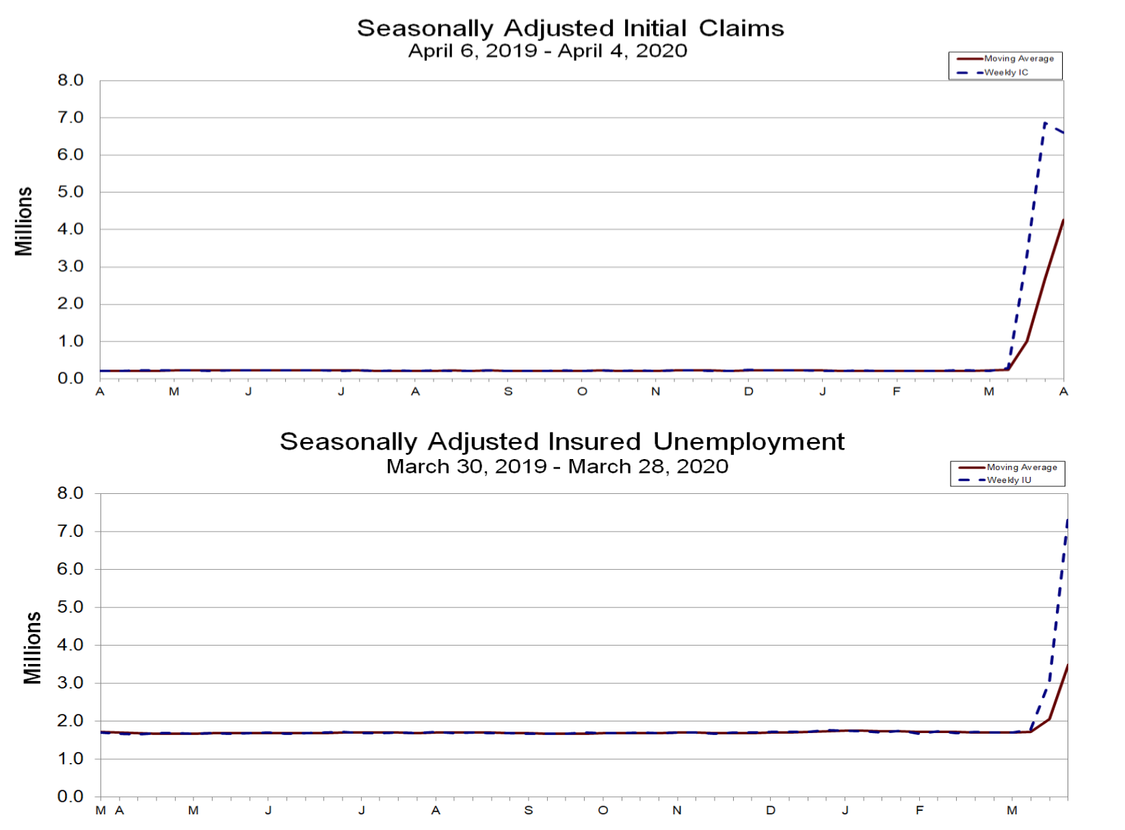
Initial Unemployment Claims and Insured Unemployment (https://www.dol.gov/ui/data.pdf)

Slide 5
Economic Projections of GDP, Unemployment Rate, Deficits and Debt
CBO (on April 2, 2020) projects that for Q2 of 2020
the unemployment rate will increase to 12% and
GDP will decrease by more than 7% from Q1 to Q2 – a more than 28% decline in GDP growth rate
but notes the declines could be much larger
JP Morgan’s latest forecast (April 10, 2020 - shorturl.at/fzENP)
20% unemployment rate
38% contraction in GDP
Committee for a Responsible Federal Budget forecasts (shorturl.at/gkDI8)
deficits of $3.8 trillion or 18.7% of GDP
debt held by public > GDP by end of 2020

Slide 6
Unemployment Data for Texas: (source: shorturl.at/fuxT5)
Unemployment claims since mid-March: 745,443 (5.3% of labor force)
Most recent week’s unemployment claims (March 29 – April 4): 313,832
Percent of workers in high-risk industries: 19.6%
Projected unemployment rate, July 2020: 15.2%
Percentage of Houston area households that payed rent on time decreased from 88% in April 2019 to 79.4% - an 8.6 percentage point increase. Highest among Texas’ largest cities (source: shorturl.at/nGHXY)

Slide 7
Small Business Health in Houston: (published by GHP: shorturl.at/bcDEO)
Data from 90 small businesses to 1st Houston Business Barometer survey April 3-6
84.3% instituted work-from-home policy
22.5% whole or partial shutdown
36% enacted a hiring freeze
53.3% operations severely impacted
28.9% impact has been moderate.
How long could firms stay open with no federal assistance under continued stay home, work safe policies:
1-2 weeks 0.0%
3-4 weeks 6.7%
5-6 weeks 6.7%
7-8 weeks 12.2%
3-6 months 26.7%
Longer than 6 months 40.0%
Don’t know 7.8%

Slide 8
Economic Responses as of 4/14/20
The first bill, Coronavirus Preparedness and Response Supplemental Appropriations Act, authorized $8.3 billion in emergency funding
$3.1 billion for the Department of Health and Human Services
$950 million for state and local health departments
$300 million for vaccine development and treatments
$1.25 billion for international aid in low- and middle-income countries
The second bill, the Families First Coronavirus Response Act, provides
free coronavirus testing to the public
paid sick and family leave program (50<size<500, $511 per day for 2 weeks, $200 per day for 12 weeks, JCT estimates that these provisions will cost $105 billion)
allocates $1 billion in grants to states for expanded unemployment insurance
dedicates more than $1.5 billion for food assistance programs

Slide 9
Coronavirus Aid, Relief, and Economic Security (CARES) Act, $2.2 Trillion
Business provisions include
$500 billion for larger companies (with $50 billion going to airlines)
$350 billion for small businesses
$150 billion to hospitals and healthcare providers.
Provisions targeted to individuals include
direct payments of $1,200 per adult and $500 per child, 5% phase-out rate above $75,000 ($150,000) for single (married) taxpayers. ($292 billion total cost)
a 13 week extension of unemployment benefits including an additional $600 per week
funding for Short-Time Compensation (STC) programs in which employers reduce hours instead of laying off workers and employees receive pro-rated benefits (federal funding equal to 100 percent if the state has a STC program and 50 percent if it creates a new STC program)
above the line charitable contributions
changes retirement plan withdrawal rules and student loan payments

Slide 10
General Rules for Evaluating Current and Future Policies
The policies enacted so far were largely necessary
More fiscal measures are likely to be required soon, starting with additional small business relief
Actions must attempt to minimize long-term harm to the U.S. economy
temporary
targeted
focused on maintaining supply chains, existing business knowledge, and sustainable consumer finances
Avoid policies (for now) such as
proposals to institute a $15 minimum wage
environmental policy changes
same day voter registration
retroactively repeal of the state and local tax deduction

Slide 11
Restarting the Economy and Recovery
Tough Decision
restart to early and virus may spread again
waiting too long may increase economic costs (and related health costs)
recovery – V, U, W, L….
Need widespread testing of population!
New normal?
Fiscal turning point – U.S. must eventually adopt sustainable fiscal policies

Slide 12
Thank you!

