Slide 1
The Euro Crisis: Perspectives From US History
October 2013
Mark A. Wynne
Vice President & Associate Director of Research
Director, Globalization & Monetary Policy Institute
Federal Reserve Bank of Dallas

Slide 2
Overview
The story so far…
The (increasingly global) fallout
Contagion from periphery to core
Contagion to the rest of the world
The fundamental challenges
Burned ships (the Cortes strategy)
The world’s greatest game of chicken
Lessons from history
End game
Move to a political union?
Or lost decade(s) à la Japan?

Slide 3
The euro crisis: a chronology
2010: Greek & Irish bailouts
2011: Portuguese & (2nd) Greek bailouts; Fiscal compact agreed; ECB LTROs
2012: Greek default; bailout of Spanish banks; ECB announces plans to conduct Outright Monetary Transactions (OMTs): EU wins Nobel Peace prize; (3rd) Greek bailout
2013: Fiscal compact enters into force; Cyprus bailout;
Notes:
Draghi statement: http://www.ecb.int/press/key/date/2012/html/sp120726.en.html

Slide 4
The story so far (10-year government interest rates)
Jan 1, 1999
Euro launched
Jan 1, 2001
Greece joins

Slide 5
Convergence in the US
Notes:
Data from Bloomberg: 10 year Municipal Bond Yields
California: 165M10Y Index
New York: 195M10Y Index
Texas:169M10Y Index
Florida:175M10Y Index
Illinois: 177M10Y Index

Slide 6
Great Depressions Unemployment Rate
(U.S.)
Notes:
US Data from Historical Statistics of the United States http://hsus.cambridge.org/HSUSWeb/table/continuedownload.do?id=Ba470-477&changeSeries=true&isTopmostOn=false
Data for Greece and Spain from IMF World Economic Outlook (October 2012 edition)
Greece:A174LUR@IMFWEO
Spain:A184LUR@IMFWEO
Ireland:A178LUR@IMFWEO
Portugal:A182LUR@IMFWEO

Slide 7
Great Depressions Unemployment Rate
(U.S.)
Notes:
US Data from Historical Statistics of the United States http://hsus.cambridge.org/HSUSWeb/table/continuedownload.do?id=Ba470-477&changeSeries=true&isTopmostOn=false
Data for Greece and Spain from IMF World Economic Outlook (October 2012 edition)
Greece:A174LUR@IMFWEO
Spain:A184LUR@IMFWEO
Ireland:A178LUR@IMFWEO
Portugal:A182LUR@IMFWEO

Slide 8
Great Depressions Unemployment Rate
(U.S.)
Notes:
US Data from Historical Statistics of the United States http://hsus.cambridge.org/HSUSWeb/table/continuedownload.do?id=Ba470-477&changeSeries=true&isTopmostOn=false
Data for Greece and Spain from IMF World Economic Outlook (October 2012 edition)
Greece:A174LUR@IMFWEO
Spain:A184LUR@IMFWEO
Ireland:A178LUR@IMFWEO
Portugal:A182LUR@IMFWEO

Slide 9
Great Depressions Unemployment Rate
(U.S.)
Notes:
US Data from Historical Statistics of the United States http://hsus.cambridge.org/HSUSWeb/table/continuedownload.do?id=Ba470-477&changeSeries=true&isTopmostOn=false
Data for Greece and Spain from IMF World Economic Outlook (October 2012 edition)
Greece:A174LUR@IMFWEO
Spain:A184LUR@IMFWEO
Ireland:A178LUR@IMFWEO
Portugal:A182LUR@IMFWEO

Slide 10
Great Depressions Unemployment Rate
(U.S.)
Notes:
US Data from Historical Statistics of the United States http://hsus.cambridge.org/HSUSWeb/table/continuedownload.do?id=Ba470-477&changeSeries=true&isTopmostOn=false
Data for Greece and Spain from IMF World Economic Outlook (October 2012 edition)
Greece:A174LUR@IMFWEO
Spain:A184LUR@IMFWEO
Ireland:A178LUR@IMFWEO
Portugal:A182LUR@IMFWEO

Slide 11
Housing booms and busts Residential investment as a share of GDP
Notes:
Arizona, Florida, and Nevada:
Ratio: (Construction/GDP)*100
Arizona: (AZD0@GSP/AZTO@GSP)*100
Florida: (FLD0@GSP/FLTO@GSP)*100
Nevada: (NVD0@GSP/NVTO@GSP)*100
U.S. Spain, and Ireland:
Ratio: (Residential Investment/GDP)*100
U.S.: (FR@USNA/S111NGDP@G10)*100
Spain: (E184IH@OECDNA/E184GDP@OECDNA)*100
Ireland: (E178IH@OECDNA/E178GDP@OECDNA)*100

Slide 12
Housing booms and busts Residential investment as a share of GDP
Nevada
Arizona
Florida
U.S.
Notes:
Arizona, Florida, and Nevada:
Ratio: (Construction/GDP)*100
Arizona: (AZD0@GSP/AZTO@GSP)*100
Florida: (FLD0@GSP/FLTO@GSP)*100
Nevada: (NVD0@GSP/NVTO@GSP)*100
U.S. Spain, and Ireland:
Ratio: (Residential Investment/GDP)*100
U.S.: (FR@USNA/S111NGDP@G10)*100
Spain: (E184IH@OECDNA/E184GDP@OECDNA)*100
Ireland: (E178IH@OECDNA/E178GDP@OECDNA)*100

Slide 13
Housing booms and busts Residential investment as a share of GDP
Ireland
Nevada
Spain
Arizona
Florida
U.S.
Notes:
Arizona, Florida, and Nevada:
Ratio: (Construction/GDP)*100
Arizona: (AZD0@GSP/AZTO@GSP)*100
Florida: (FLD0@GSP/FLTO@GSP)*100
Nevada: (NVD0@GSP/NVTO@GSP)*100
U.S. Spain, and Ireland:
Ratio: (Residential Investment/GDP)*100
U.S.: (FR@USNA/S111NGDP@G10)*100
Spain: (E184IH@OECDNA/E184GDP@OECDNA)*100
Ireland: (E178IH@OECDNA/E178GDP@OECDNA)*100

Slide 14
“The laws of economics grind slowly, but they grind exceedingly fine”
Euro area does not satisfy the criteria of an “optimum currency area”
Implication: living with a “one-size-fits-all” monetary policy will create strains
Illustrate with comparison to US monetary union
How would individual US states conduct monetary policy if they were free to do so?
Taylor Rule as guide
Notes:
Quote in title from here: http://books.google.com/books?id=VWRNAAAAYAAJ&pg=PA122&lpg=PA122&dq=laws+of+economics+grind+slowly+but+grind+exceedingly+fine&source=bl&ots=f-QY6GoJI6&sig=93kk08cPOtiE9NkLpbtpC5wCG3c&hl=en&sa=X&ei=qtxaUqbUKZex4AOOroDADw&ved=0CDUQ6AEwAg#v=onepage&q=laws%20of%20economics%20grind%20slowly%20but%20grind%20exceedingly%20fine&f=false

Slide 15
California: output gap & inflation

Slide 16
California: Implied Taylor rule rate

Slide 17
California: Fed funds rate & Taylor rates

Slide 18
U.S. BEA regions Taylor rule rate range

Slide 19
Euro area Taylor rule rate range

Slide 20
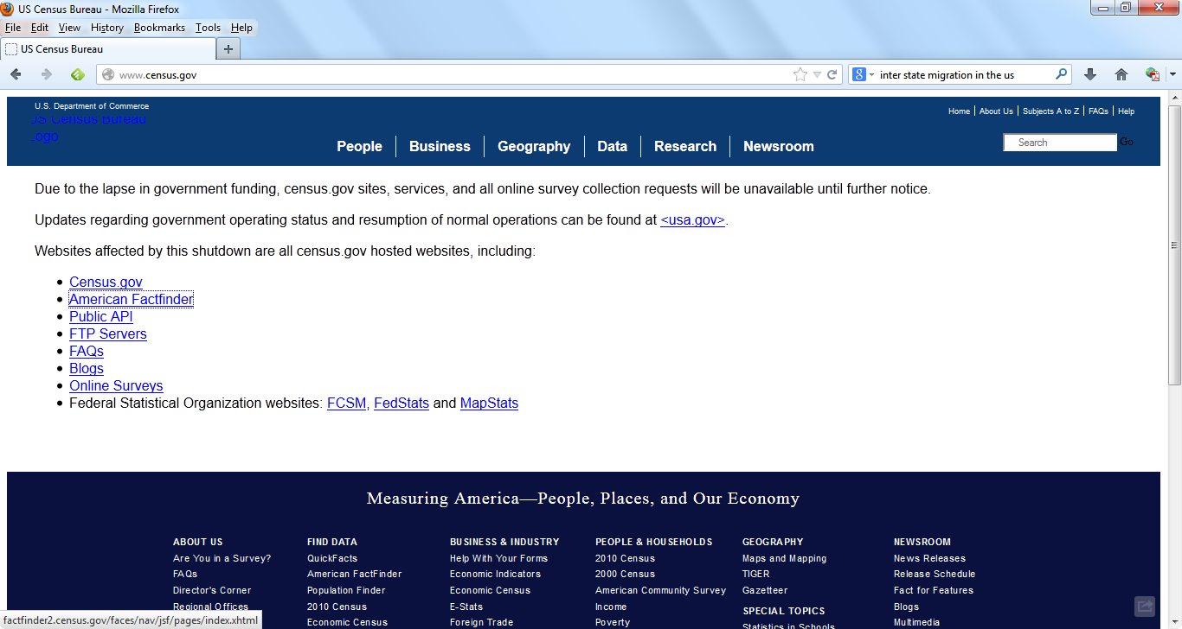

Slide 21
Variation in unemployment rates
Notes:
These are unemployment rates range by US BEA regions as in EL

Slide 22
Variation in unemployment rates
Notes:
These are unemployment rates range by US BEA regions as in EL

Slide 23
Variation in unemployment rates
Notes:
These are unemployment rates range by US BEA regions as in EL

Slide 24
Fixes
Monetary union can exist without a fiscal union
But need rules to make it work
Tried and failed in Europe
Fiscal & political union along U.S. lines
Tighter constraints on ability of member states to run deficits
Pooling of regional risks, especially of banking system risks

Slide 25
Lessons from U.S. history
The United States in 1780s
Fiscal crisis associated with servicing debt incurred during Revolutionary War
Solution: strengthen powers of federal government (replace Articles of Confederation with U.S. Constitution)
Federal government assumed debts of states
One-time bailout: states allowed to default in 1840s
States adopted balanced budget rules thereafter

Slide 26
Deficits in peripheral European countries comparable to U.S. deficits
Budget deficits as a share of GDP
Percent
Notes:
Source: Haver Analytics
See Budget Deficits.xlsx
For U.S.:
Deficit as percent of GDP: FTTGDPM@USECON
For GIIPS:
Greece: Deficit as percent of GDP: G174DFP@EUDATA
Nominal GDP: A174GDP@IMFWEO
Ireland: Deficit as percent of GDP: G178DFP@EUDATA
Nominal GDP: A178GDP@IMFWEO
Italy: Deficit as percent of GDP: G136DFP@EUDATA
Nominal GDP: S136NGDP@G10
Portugal: Deficit as percent of GDP: G182DFP@EUDATA
Nominal GDP: S182NGDP@G10
Spain: Deficit as percent of GDP: G184DFP@EUDATA
Nominal GDP: S184NGDP@G10
Weight: (country’s nominal GDP)/(sum of all GIIPS countries’ GDPs)
Weighted deficit for each country: Deficit as percent of GDP * Weight
GIIPS weighted deficit: Sum of all countries’ weighted deficits

Slide 27
Fiscal situation of Europe as a whole relatively sound
Government debt as a share of GDP
Percent
U.S.
Euro area
Note: Diamonds indicate OECD forecasts.
Notes:
Source: Haver Analytics
OECD Euro Area: Gen Gov Net Fin Liabilities, as a % of GDP
A026GNLP@OUTLOOK
United States: Gen Gov Net Fin Liabilities, as a % of GDP
A111GNLP@OUTLOOK

Slide 28
Disunion
Declining trust in European institutions
Just 31 percent compared to 57 percent before crisis
Less favorable image of the EU
Majority (52 percent) still support the single currency
Down from 61 percent before crisis

Slide 29
Demographic destinies? (Population in millions)

Slide 30
Demographic destinies? (Population in millions)

Slide 31
Conclusions
Euro crisis a vindication of economic theory
New “fiscal compact”
A significant improvement over earlier Stability and Growth Pact?
EMU 2.0 workable?
Challenges
Achieving consensus on new rules: loss of sovereignty
Market rigidities
Austerity programs
Potential for social unrest
Europe 1914

