Slide 1

The Eurocrisis Minefield: Mapping the Way Out
Euro Area Institutional Framework, Crisis Causes and Policy Options
Houston, Baker Institute
October 14, 2013
Andrea Montanino
Executive Director
International Monetary Fund

Slide 2
Outline of the presentation
  Where we stand – economic and financial developments
Why we stand there – input causes and structural weaknesses
Strength elements – past and present European key factors
Policy reactions – strong fiscal, monetary and institutional responses
Policy recommendations - IMF Article IV recommendations
A. Montanino

Slide 3
Where we stand A self fuelling vicious cycle….
Weak growth
Credit crunch
Sustainability
Low profitability
Higher interest rates
Stressed banking sector
High public debt
Bailout effects
High sovereign spreads
A. Montanino

Slide 4
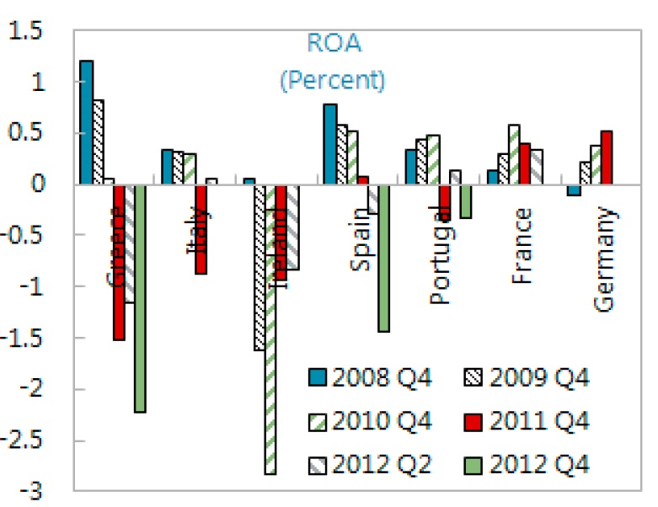
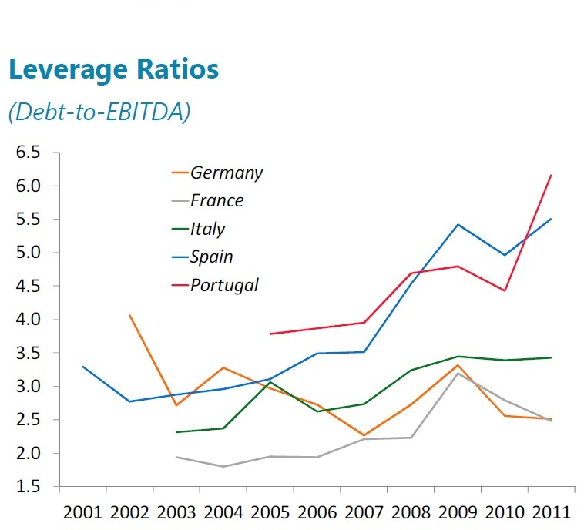
Where we stand Low profits and high indebtedness…
Corporate profitability has declined in most countries
Corporate debt increased in Portugal and Spain even after 2009 recession
A. Montanino
Notes:
All countries (including France, excluding Germany) have experienced declining corporate ROA in 2010-2012

Slide 5
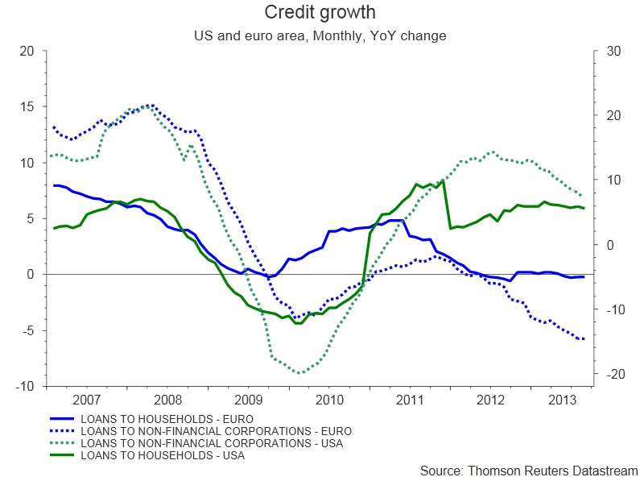
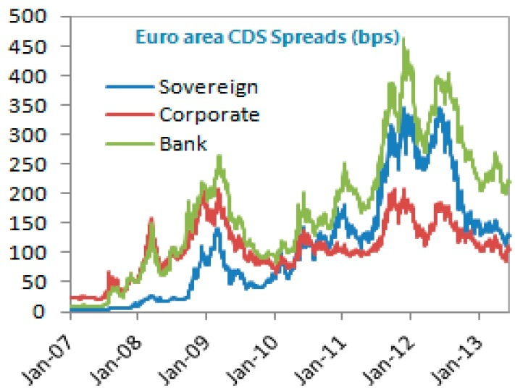
Where we stand …cause strict credit conditions…
Credit growth to households and firms is stuck or negative since early 2012
Credit conditions (collaterals, rates, etc) are still stricter than in 2008
Non Performing Loans on Total Loans are growing, resulting in higher perceived bank risk
A. Montanino

Slide 6
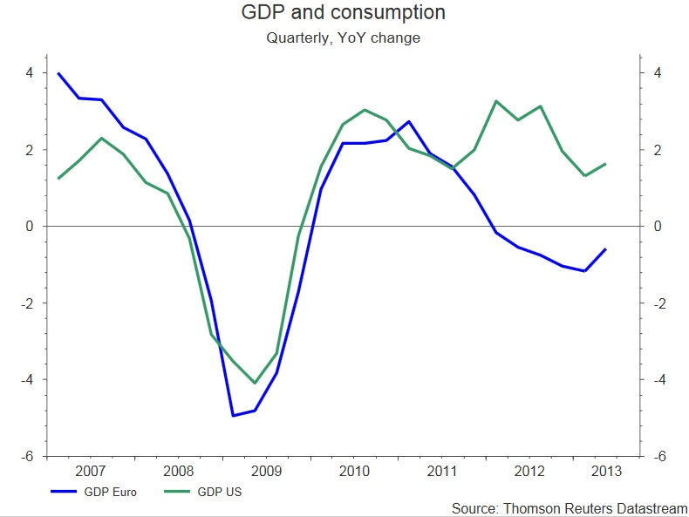
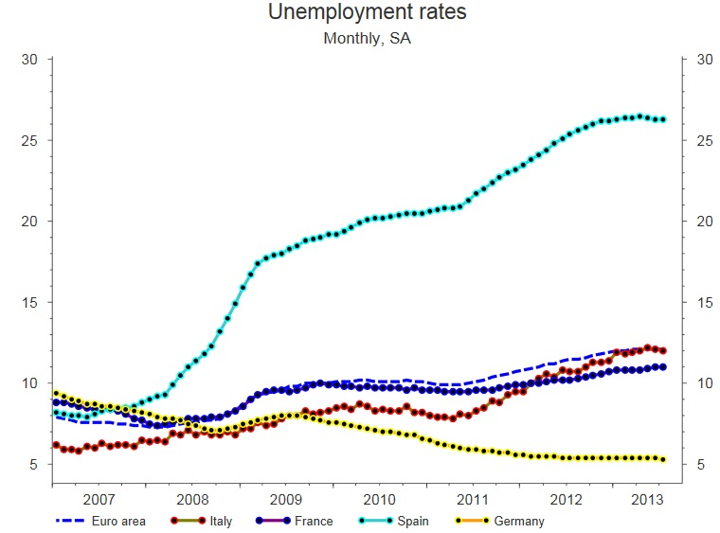
Where we stand …which in turn result in weak growth and high unemployment
GDP Growth
YoY change
SMEs employ a huge proportion of workers in many countries
Credit restriction is affecting a high percentage of SMEs
Unemployment tends to increase more in those countries
A. Montanino
Notes:
SMEs are the key industrial model in many countries, but in Italy this is outstanding
Data above are referred to 2010, before the major credit crunch (WEO oct 2013)

Slide 7


Why we stand there A crisis come from the outside…
Exposed
Banks
Mortgage Crisis
Subprime crisis
Us Housing Bubble
Real economy
fall
Exporting Firms
Low demand
US
Euro
A. Montanino

Slide 8
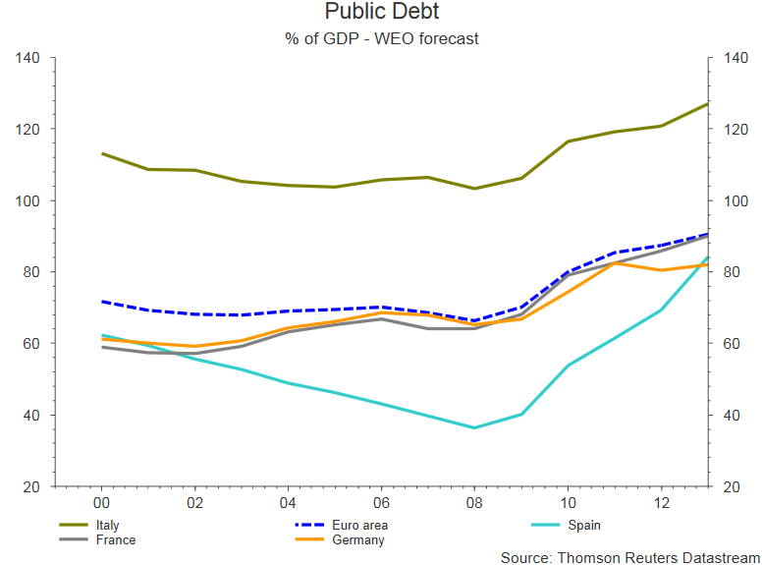
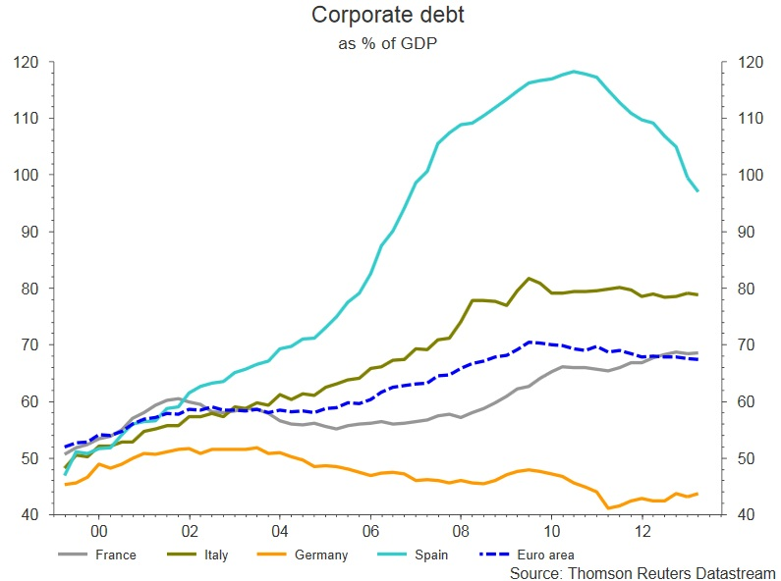
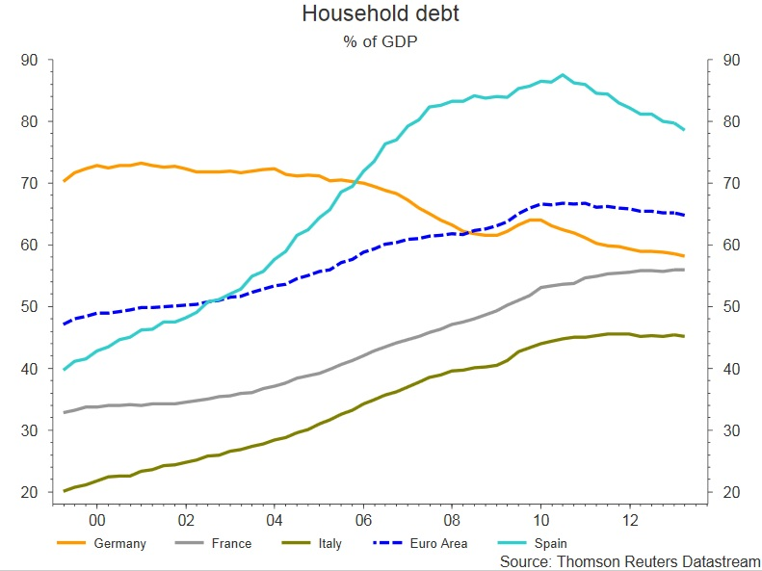
Why we stand there ….exacerbating prior issues /1
A. Montanino
Notes:
Note that Italian corporate debt does not increase after 2009

Slide 9











Why we stand there ….exacerbating prior issues /2
Government
Households
Firms
A mix of private and public indebtedness can be critical to some countries!
IT
FR
BE
GR
IR
PT
NL
SP
MLT
FIN
CYP
A. Montanino
Notes:
WEO oct 2013

Slide 10
Strength elements But euro-economies could count on past and present key elements…
Markets could count on:
Diversified economies with a strong industrial component and
well-developed financial markets
Solid, long-standing and determined institutions:
    European Council -> Political commitments
    European Commission -> Policy enforcement
    European Central Bank -> Monetary intervention
    National Central Banks -> Supervision
    European Investment Bank -> Lending support
A. Montanino

Slide 11
Strength elements … like manufacturing….
2000
2010
Top 10 Manufacturers, by Value Added (current US$)
EMEs abrupt rise
Despite BRICs’ role, Germany and Italy remain in the top 5 manufacturer chart!
Source: World Bank
A. Montanino
Notes:
Data considering US 2005 dollars do not change the ranking that much, especially not for Germany and Italy

Slide 12
Strength elements …and firms that could successfully exploit new markets…
Exports by destination
2000
2011
Others
Others
38.2%
41.1%
US, 38.3%
US, 56.6%
China,
China,
5.2%
20.6%
A. Montanino
Source: Eurostat

Slide 13
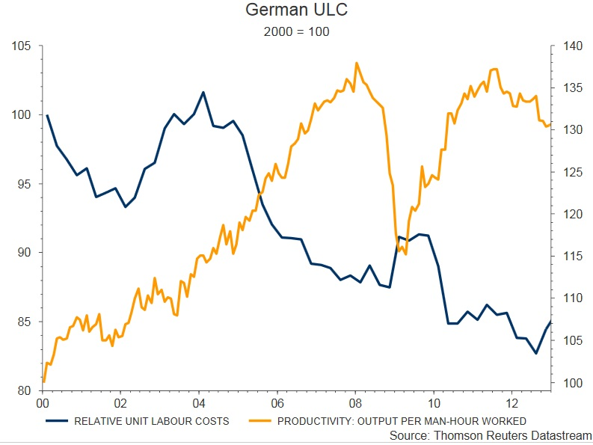
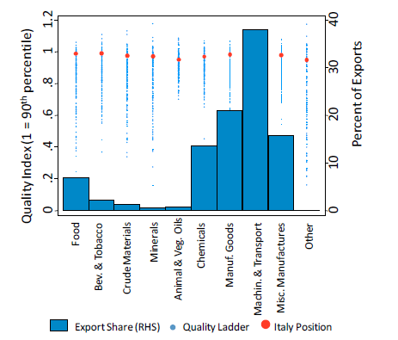
Strength elements …and were able to compete on costs and/or quality…
Germany - productivity
Italy - quality index
A. Montanino

Slide 14
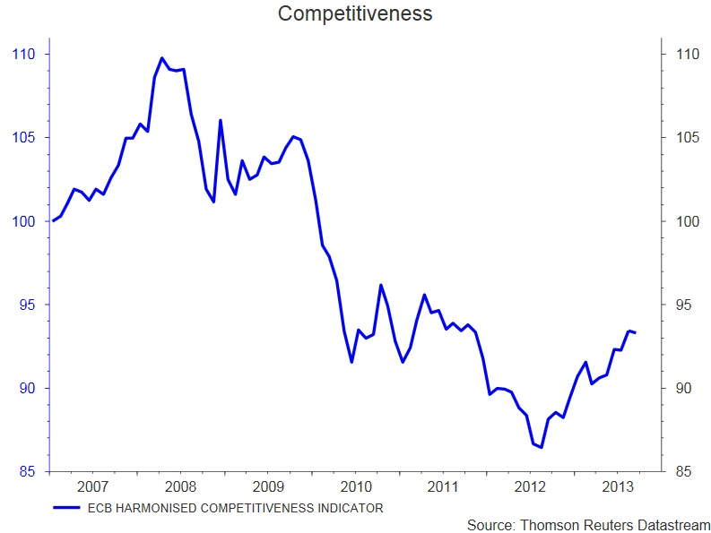
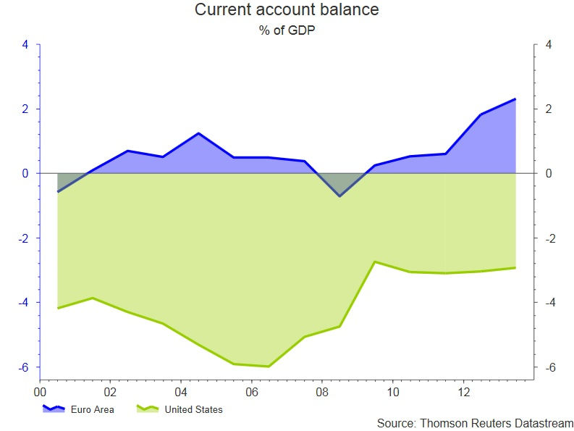
Strength elements … in the view of gradual competitiveness improvements and export-led recovery
A. Montanino

Slide 15
Policy reactions How did Europe respond?
The policy response has been mainly timely, firm, consistent and coordinated
The mix of centralized monetary intervention and country-tailored fiscal efforts paved the way for recovery and future structural interventions
Responses were directed to specific fields of interventions (housing, banking, labor market), to restore financial market confidence and to strengthen the institutional framework.
A. Montanino

Slide 16
Policy reactions How did Europe respond?
Fiscal Policy | Monetary Policy | Structural & Institutional Reforms
Financial assistance to the banking sector | Rate cuts | Basel III
Fiscal consolidation | ECB asset expansion | Temporary and permanent assistance mechanisms
 | Unconventional monetary policy | Fiscal Compact
 |  | Banking Union
A. Montanino

Slide 17
Policy reactions State assistance to the banking sector
Source: Eurostat
A. Montanino

Slide 18
Policy reactions Fiscal consolidation has been effective…
Tax hikes
 | Overall Balance (% GDP) |  | Primary Balance (% GDP) |  | Structural Balance (% pot. GDP)
 | 2010 | 2013 | 2010 | 2013 | 2010 | 2013
GER | -4.1 | -0.4 | -2.0 | 1.7 | -2.3 | -0.5
IT | -4.3 | -3.1 | 0.0 | 2.1 | -3.2 | 0.6
FR | -7.1 | -3.9 | -4.8 | -1.9 | -4.6 | -2.0
ES | -9.7 | -6.7 | -8.3 | -3.8 | -7.3 | -3.1
Consolidation
Spending Review
Public wages cuts
Privatizations
A. Montanino

Slide 19
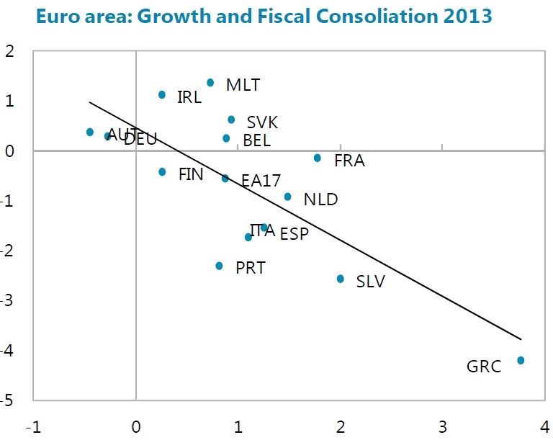
Policy reactions ….but produced near-term side effects…
Fiscal consolidation continues to weigh on activity
GDP in the euro area is forecast to shrink by 0.5%in 2013
Growth is expected to recover from an annual rate of 0.75 percentage points in the second half of 2013 to about 1% in 2014, driven by a smaller fiscal drag (WEO Oct 2013)
Growth rates 2013
Change in structural balance
A. Montanino
Notes:
WEO oct 2013

Slide 20
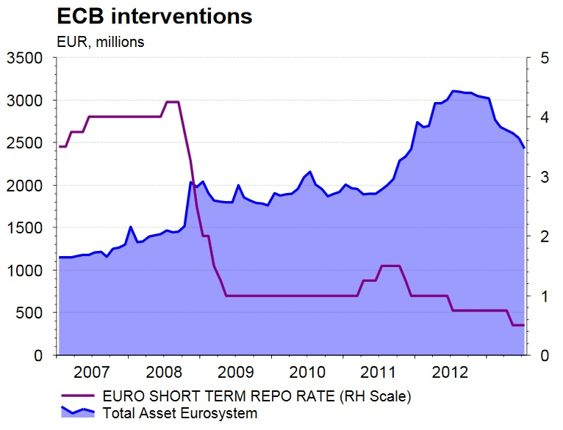
Policy reactions Monetary intervention was massive…
Rates no higher than 1.5% since May 2009;
Unprecedented ECB balance sheet expansion;
Unconventional monetary policy tools, among which:
  Long Term Rifinancing Operations (LTROs)
  Outright Monetary Transactions (OMTs)
OMTs
LTROs
A. Montanino

Slide 21
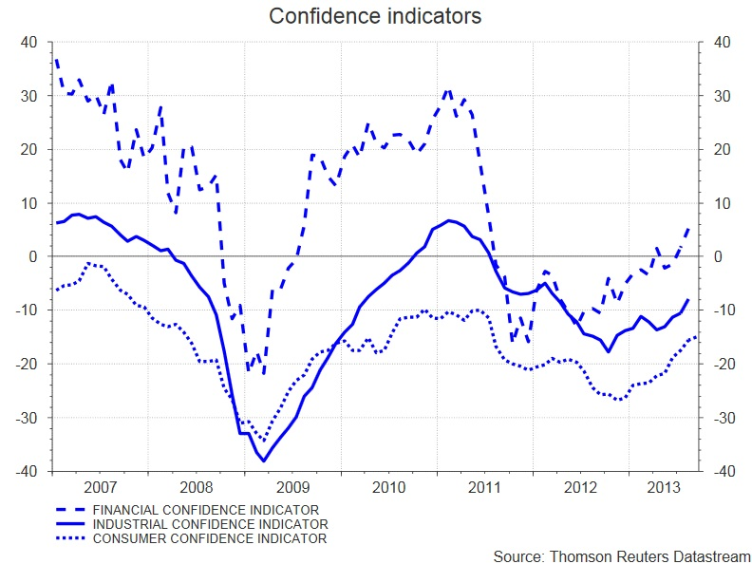
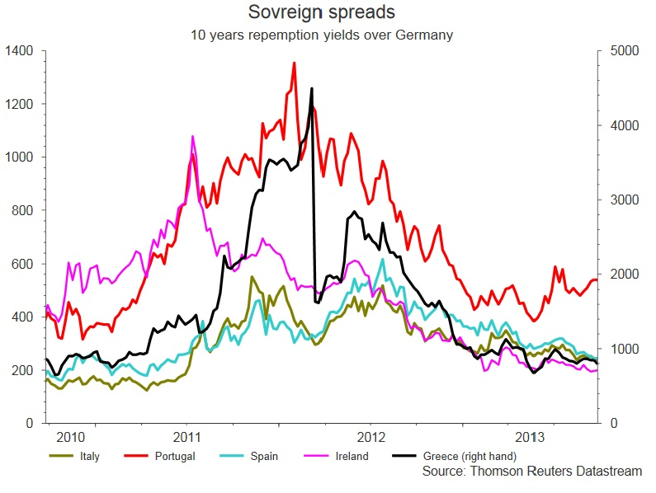
Policy reactions …and helped restore confidence
Confidence indicators are a good proxy for uncertainty and are correlated with economic activity
2013 confidence increase could hopefully pave the way for a full 2014 recovery
Since end-2011 spreads dynamics has been encouraging, although levels are still high and the implementation of structural reforms is crucial.
A. Montanino

Slide 22
Policy reactions Structural and institutional reforms
Institutionalized mutual assistance | Fiscal Compact | Banking Union
The EFSM (European Financial Stabilization Mechanism) is an emergency funding program reliant upon funds raised on the financial markets and guaranteed by the European Commission using the budget of the European Union as collateral up to €60 billion. The EFSF (European Financial Stability Facility) is a special purpose vehicle financed by members of the euro zone to address the European sovereign-debt crisis, with the objective of preserving financial stability in Europe The EFSF is authorized to borrow up to €440 billion. ESM (European Stability Mechanism) The ESM is a permanent crisis resolution mechanism for the countries of the euro area. The ESM issues debt instruments in order to finance loans and other forms of financial assistance. Established by the European Council and Member States. Inaugurated on 8 October 2012. | Treaty strengthening fiscal discipline within the euro area through a “balanced budget rule”. Annual structural government deficit must not exceed 0.5% of GDP at market prices. Member States whose government debt-to-GDP ratio exceeds the 60% reference level, shall reduce it at an average rate of at least one twentieth (5%) per year of the exceeded percentage points, where the calculated average period shall be either the 3-year period covering the last fiscal year and forecasts for the current and next year' or the last three fiscal years In the event of deviation, an automatic correction mechanism is triggered. Entered into force on 1 January 2013 | Ongoing process, based on: SSM (Single Supervisory Mechanism): led by the European Central Bank, voted by European Parliament on 12 September 2013 Single Resolution Mechanism: proposed by European Commission on 10 July 2013. It envisages a Single Resolution Board consisting of representatives from the ECB, the European Commission and the relevant national authorities
A. Montanino

Slide 23
Policy reactions EU-ECB-IMF Programs for Euro Area countries
Greece | Ireland | Portugal | Cyprus
3/14/2012: euro area finance ministers approved financing of the Second Economic Adjustment Program for Greece (Euro 144.7 billion to be provided via the EFSF) 3/15/2012: IMF 4-year arrangement under the Extended Fund Facility (SDR 23.79 billion; Euro 28 billion) | 12/7/2010: the agreement was adopted on a 3-year Economic Adjustment Program which includes a joint financing package of Euro 85 billion with contributions from the EU/EFSM (Euro 22.5 billion), euro area Member States/EFSF (Euro 17.7 billion), 4.8 billion in bilateral contributions as well as funding from IMF (Euro 22.5 billion) | 5/17/2011: the agreement was adopted on a 3-year Economic Adjustment Program which includes a joint financing package of Euro 78 billion (EU/EFSM 26 billion, Euro area/EFSF 2 6 billion, IMF about 26 billion) | 4/2/2013: the agreement was adopted on an Economic Adjustment Program for the period 2013-2016. The financial package covers up to Euro 10 billion (ESM 9 billion, IMF around 1 billion)
A. Montanino

Slide 24
Policy recommendations IMF -Euro area Article IV consultations
  Repairing banks balance sheets (Asset Quality Review, involvement of an independent third party, agreed strategy on how to address capital shortfalls)
  Making further progress on banking union (Single Supervisory Mechanism, Single Resolution Mechanism, common safety nets, accompanying directives)
  Providing sufficient near-term support (additional unconventional monetary policy support, paced fiscal adjustment)
  Advancing structural reforms (targeted implementation of the Services Directive, new round of Free Trade Agreements, improved portability of pensions and unemployment benefits, continued labor market reforms)
A. Montanino

Slide 25
Policy recommendations IMF –Selected Article IV consultations
Germany | Italy | France | Spain
The small projected loosening of the fiscal stance is appropriate and fiscal over-performance should be firmly avoided in the current growth environment Financial reform momentum should be maintained both at the domestic and the euro area level in order to alleviate uncertainty and reduce downside risks. The main priorities are to build on recent improvements in financial stability and on progress towards reversing the fragmentation of banking systems across Europe Over the medium term, efforts to raise the German economy’s growth potential need to be sustained | Improving the business environment and creating jobs Reducing public debt and rebalancing adjustment Strengthening banks’ balance sheets and lending | The pace of fiscal adjustment should be eased in 2014 to support the recovery, while envisaging expenditure containment The momentum of structural reforms will need to be powered up, by deepening labor market reforms and opening product markets to greater competition Tax incentives on financial products should be better aligned to regulatory objectives | Labor market reforms need to go further, increasing firms’ internal flexibility, reducing duality and enhancing employment opportunities for the unemployed The insolvency regime should be further improved to provide incentives for accelerating debt workouts In the banking system it is necessary to continue to reinforce capital, to clean up loan books and to remove credit supply constraints Fiscal consolidation should continue, but be as gradual and growth friendly as possible Competition should be improved Europe should move faster to full banking union
A. Montanino

Slide 26
In conclusion
Europe is ahead of a slow and difficult recovery…
…cause by a financial crisis started abroad and by prior unsolved issues….
…but the key economic and institutional framework….
…facilitated a strong articulated policy response….
…though more still needs to be done!
A. Montanino

Slide 27
Thank you
A. Montanino

