Slide 1
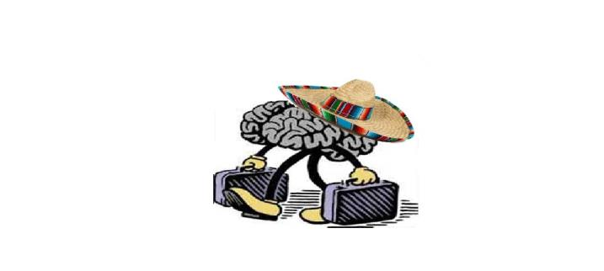
The Other Immigrants: Mexican Brain Drain to the United States
Jesus Velasco
Mexico Center, Rice University
May 21th, 2015

Slide 2
Mexican Immigrants

Slide 3
Mexican Immigrants

Slide 4
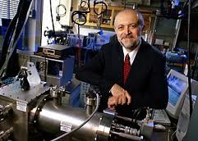
The Other Immigrants

Slide 5
The Other Immigrants

Slide 6
The Other Immigrants

Slide 7
The Other Immigrants

Slide 8
Purpose of the Presentation
Offer an explanation of why Mexican High-skilled workers are leaving Mexico and coming to the US.
Assess the Implications of this kind of Immigration for Mexico and the U.S
In doing so, I will attest that theories of High-skill migration do not explain the Mexican Case and propose a Multi-causal method.

Slide 9
General Thesis
The structural reasons that provoke Mexican High-skill migration to the USA will not be solved in the near future, so Mexican high-skill migration to the USA and other parts of the world will continue.

Slide 10
Division of Presentation
1) Theories of High-skill Migration
2) Number of High-skilled Mexicans leaving the USA
2) Explanation of why they are moving to the USA
3) Implications for Mexico and the USA
4) Some concluding remarks

Slide 11
Theories Immigration and High-Skill Migration
1) Neoclassic Theory. (Explains Brain Drain).
2) The New Economics of Migration.
3) The Network Theory
4) World System Theory

Slide 12
Theories of High-Skill Migration
These theories do not explain:
A) Personal Insecurity.
B) Fear of Crime.
C) Professional Development.
D) Does not explain why Mexican with higher Income move to the USA.
We Need a Multi-Causal Methods that combine quantitative and qualitative methods.

Slide 13
Some Numbers
College-Educated Mexicans living in the US
Year 2000= 300,000
Year 2010= 530,000
Mexicans= 7.2 years of education
30,000 Mexican with a Ph.D.
11,000 Live in the United States

Slide 14
Some Numbers
National Council of Science and Technology (CONACYT)
2012= 4,559 Studying MA or Ph.D. Abroad.
1,271 (27.9%) in the USA
2014= 5,205
1) 42.1% (2,191) Ph.D.
2) 30.6% (1,595) MA
3) 27.39% (1,419) Technical Specialties

Slide 15
Who are They?
The Best Mexicans:
1) Rodlfo Dirzo
2) Mario Molina
3) Alfredo Quiñonez
4) Salvador Moguel (Union College, Nebraska)

Slide 16
Rodolfo Dirzo

Slide 17
Rodolfo Dirzo
B.A. Universidad Autonoma de Morelos
Ph.D. University of Wales.
1) Awarded Presidential Medal in Ecology, Mexico in 2003.
2) Chair, Biology Section Mexican Academy of Sciences.
3) Member US National Academy of Sciences.
4) Member, American Academy of Arts and Sciences
5) Member California Academy of Sciences.

Slide 18
Alfredo Quiñonez

Slide 19
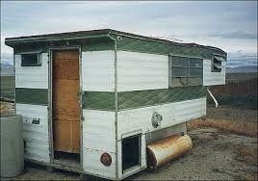

Slide 20
Why are they moving to the US?
1) Welcoming of Educated Mexicans
President and Congress Welcome. (Green Cards, MA or Ph.D.)
Private Sector: Bill Gates: “We Need to Attract and Retain the Brightest and most Talented People Around the World.”
US Universities Support Free Market of Brains.
Yale= Seeks to Attract a Diverse Group of Exceptionally Talented Men and Women from Across the Nation and Around the World.

Slide 21
Why are they moving to the US?
2) Lack of Proper Research Infrastructure and Resources
GDP in R&D
Mexico=0.39% of GDP, 2013 historic 0.51%
Israel= 4.20%
Finland= 3.80%
South Korea 3.45%
United States 2.68%.
Brazil= 1.25%
Argentina=0.61%

Slide 22
Why are they moving to the US?
Lack of Infrastructure
Clara Gorodezky
Laura Trejo.

Slide 23
Why are they moving to the US?
3) Instability of Research Institutions.
-Politics in Academia.
-Union Strikes.
-Student’s Strikes
-Government Pressures to Change Research.
-Political Appointees.
-Government Bureaucracy (Funds).
-University Bureaucracy, etc.

Slide 24
Why are they moving to the US?
4) Salary Gap and Unclear Route for Professional Promotion.
Average Salary Assistant Professor in Political Science
Mexico= $30,000.
UT Austin=$85,000
Medical Science Assistant Professor
Mexico=$22,000
Molecular Genetics and Microbiology
UT Austin= $79,817

Slide 25
Why are they moving to the US?
Full Professor in Medical Sciences
Mexico= $100,000 Clear Plus benefits (Aguinaldo, SNI).
UT Austin= Molecular Genetics and Microbiology is $160,000
Problems of Living in Mexico.

Slide 26
Why are they moving to the US?
5) Security Reasons.
Thefts Incidents:
2006= 545,251
2012= 711,168
Kidnappings
2006= 733
2012= 1,317
2013= 1,698
2014= (January-April 683)
Extortion
2006= 3,157
2012= 6,038
2013= 8,042

Slide 27
Why are they moving to the US?
México Unido Contra la Delincuencia, Feb 2015.
Mexicans Victims of Crime
January 2010= 22.5%
January 2011= 26%
January 2012= 36%.
January 2013= 23.2%
January 2014= 24.5%
February 2015= 30.8%

Slide 28
Why are they moving to the US?
Intentional Homicide
2006= 11,806
2012 =20,555
60% of Mexicans are Afraid of Kiddnaping or Robbery (2014).
Survey 148 Highly Skilled Mexican Workers
113, or 76% Insecurity Reason they Live in other Countries .
Insecurity, Central for Mexicans’ Migration to Australia

Slide 29
Why are they moving to the US?
Insecurity, Reason Decline in Number of US Temporary Students.
Institute for International Education.
Costa Rica and Argentina, Number one and two in Latin America.
Costa Rica received in
2009/2010= 6,262
2010/2011= 7,230
2011/2012= 7,900
2012/2013= 8,497

Slide 30
Why are they moving to the US?
Mexico Received in
2009/2010= 7,157
2010/2011= 4,167
2011/2012= 3,815
2012/2013= 3,730

Slide 31
Implications: Benefits for the USA
US as a Free Rider: People Educated in Mexico
Studied Abroad with Money from the Mexican Gov.
Few Times with the Money of Bilateral Organizations. (Fulbright).
Fewer Times with American Money.

Slide 32
Implications: Benefits for the USA
2) The US is Receiving Highly Qualified Mexicans
In the US the Filter for Good Students and Professionals is done by the Universities.
In Mexico it is done by the Universities, the Government, the American Universities and Job Market.

Slide 33
Implications: Benefits for the USA
3) Contribute to American and Global Science and Shaping American Science and Culture.
Mexican Scientists Bring a Background that Shape the Work and Science of the USA.
Ignacio Chapla=flow of transgenes from genetically modified corn into Mexican wild maize (Oaxaca).
Rodolfo Dirzo= Loosing Megafauna and Risk of Diseases For Local Communities. (Chiapas).

Slide 34
Implications for Mexico
1) Mexico is loosing some of its best professionals
2) These people do not pay taxes.
3) Do not send remittances.
4) Do not contribute to the reputation of Mexican Academia.
5) They are not training or mentoring Mexicans

Slide 35
Mexican Policy of Retention
1) National Research System (NRS or SNI).
2) CONACYT Runs a repatriation program.
3) Not enough

Slide 36
Brain Circulation
Louis Pasteur: “Science Knows no Country”
Scientists produced Knowledge and Knowledge is a pure, global, public, good
High-skilled workers can contribute to Mexico:
1) Research Collaboration Across borders.
2) Circulation of Professionals.
3) Transfer of Know-how

Slide 37
What is Mexico Doing To Promote Brain Circulation
Mexican Talent Network (MTN)
“Stop the Brain Drain is a Lost Battle.”
Government Work with People who have Already Gone.
These Require Synergies Between Professionals Abroad and Home Country Institutions.

Slide 38
Brain Circulation: What can Mexico Do
1) Identification of Scholars.
2) Support by CONACYT to Mexican scholars working abroad.
3) Joint Projects between Between Mexican and American Universities.
4) Transnational Teaching Models (Skype, Google Groups).
5) Transnational Dual Appointments

Slide 39
Concluding Remarks
1) US has an Immigration Policy to Retain and Attract High- skilled Workers but Mexico does not.
2) Given Disparities in higher education this Tendency will continue.
3) Higher Education and R&D are already a Common enterprise between Mexico and the US.
4) Possible Solution: a bi-national Brain Circulation Program

Slide 40
Concluding Remarks
Mexico will Continue Loosing its Professionals because the structural Reasons that are Propelling Mexicans to move to the USA are not going to Change in the Near Future.

