Slide 1
RICE UNIVERSITY’S BAKER INSTITUTE OF INTERNATIONAL ECONOMICS
The Euro-Crisis Minefield: Mapping the Way Out
The Challenges of the Corporate Sector in the Eurozone
PRESENTED BY
GEORGE TSETSEKOS
Dean Emeritus and Francis Professor of Finance
October 9, 2013

Slide 2
TWO CRISES IN THE EUROZONE
The Global Crisis of 2008-09 and the Sovereign Crisis 2009-?
Key Issues:
EZ as a currency union
Characteristics of the euro area financial market
Policies for Liquidity support vs. Solvency.
Results
Asymmetries and redistribution consequences
Macro ineffectiveness

Slide 3
Lessons Learned
Good intensions wrong Design /Architecture
Monetary not fiscal union
It is all about banks and the perils of financial integration
2. Two amplification mechanisms
From banks to banks
From sovereigns to banks and vice-versa
3. The Adjustment Program (Austerity)

Slide 4
CHARACTERISTICS OF THE EURO AREA FINANCIAL SECTOR
Banks-based
Importance of wholesale, in particular interbank funding (mostly unsecured and on balance sheet)
Transactions integrated within the Euro area
Banks in the euro area have big role in intermediating government bonds

Slide 5
Focus on the Banking Sector
Banking is everything in the Eurozone
Systemic issues – Too Central to Fail
An upcoming problem: Adverse feedback loop
Sovereign debt crisis → Banking crisis →credit contraction → Corporate lending contraction→ cost of capital increases
Sovereign debt crisis → Austerity → Decline in product demand → decline in corporate revenues → NPLs → Banking Crisis
Sovereign debt crisis → deleveraging of the corporate sector → unwilling to borrow -→adverse impact on the economy → limited growth → Decline in product demand

Slide 6
The next Big Issue in the EZ
Sovereign Debt Crisis
Banking Crisis
Corporate Crisis

Slide 7
Challenges for the Corporate Sector in the Eurozone
High Corporate Leverage
Credit Contraction
Revenue and profit declines
Global Competitiveness

Slide 8
However… “Size” Matters
Challenges | Large Firms | Small Firms
High Corporate Leverage | Deleveraging | Liquidation
Credit Contraction | Long term funding | Working Capital Funding
Revenue and profits declines | Restructuring | Bankruptcy
Global Competitiveness | Competitive Adjustments | Reorganization

Slide 9
…yet small firms add to the economic activity in the EZone
SMEs created 85% of new jobs in the EZone
Large firms created 10% of new jobs
Public/Nationals created 5% of new jobs
Source: Job creation 2002-10. ECB Annual report 2011

Slide 10
..the impact of the EZone Crisis ...
Disastrous for small firms
Contained/Controlled in large firm
… yet in periphery countries small firms dominate economic activity..

Slide 11
The Contribution of SMEs in the EZ
Country | % Share of Employment | % Share of Value added
Austria | 68% | 69%
Belgium | 64% | 62%
Finland | 62% | 57%
Germany | 63% | 54%
France | 62% | 55%
Portugal | 79% | 78%
Greece | 85% | 80%
Spain | 76% | 69%
Slovenia | 71% | 73%
Slovakia | 60% | 62%
Core vs. Periphery
 | % Share of Employment | % Share of Value added
Core Area | 64% | 59%
Periphery | 74% | 73%

Slide 12
Access to Corporate Financing
Differs among the EZ members
Bank lending is constrained for small firms and easier for larger firms
Periphery country firms

Slide 13
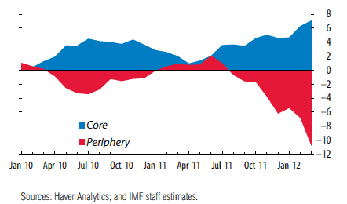
Investment Flows in Euro Area Cumulative from 2009Q4 in % of GDP

Slide 14
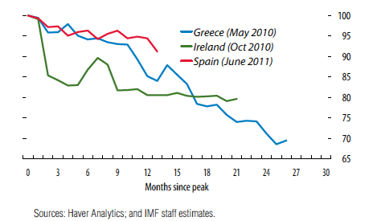
Bank Deposit Trends Peak =100

Slide 15
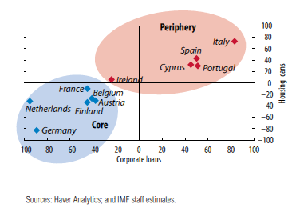
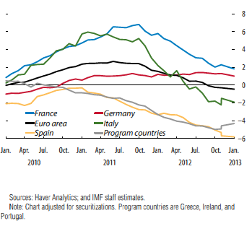
Lending Rates and Borrowing Costs Key differences in Periphery vs. Core
Changes in interest rates for bank loans 2010-13Q3
Bank Lending to Corporate Sector 2010-13

Slide 16
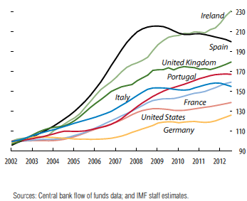
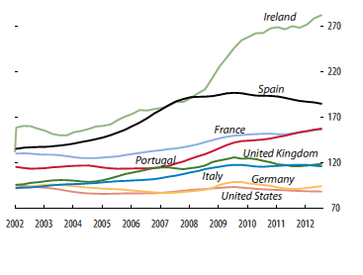
Corporate Debt Core vs. Periphery
Debt - 2002Q1=100
Debt as % of GDP

Slide 17
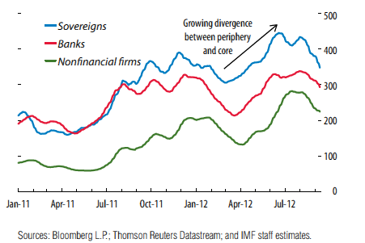
CDS Spreads Periphery Minus Core
In bps

Slide 18
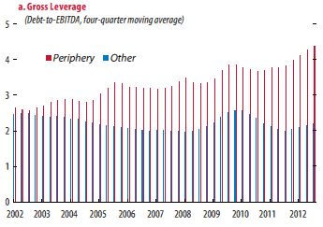
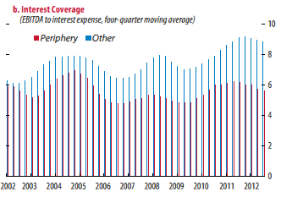
Corporate Fundamentals

Slide 19
Adjustable borrowing rates for corporates

Slide 20
Key Concerns for the Corporate Sector
Capital flight to safer Euro-zone countries
Private capital has been replaced by public sector flows
Funding asymmetries (corporate costs are very high)
Liquidity in the core is not recycled in the periphery
Current account imbalances
Notes:
Accumulated debts that Greece cannot service
Public sector Deficits
Tax evasion; needs new tax enforcements
Inefficient public sector; corruption in procurement
Economic model that generates lack of competitiveness
Union Power increasing wages and salaries
Closed sectors including taxis, trucks , engineers, lawyers etc
Fixed exchange rates locked into the Euro

Slide 21
Crisis and Deleveraging
Deleveraging pressure on Banks and Institutions
Asset write-downs and write-offs
Cost $3.6 Tr ($2.8 Tr - $4.5Tr)
Notes:
Accumulated debts that Greece cannot service
Public sector Deficits
Tax evasion; needs new tax enforcements
Inefficient public sector; corruption in procurement
Economic model that generates lack of competitiveness
Union Power increasing wages and salaries
Closed sectors including taxis, trucks , engineers, lawyers etc
Fixed exchange rates locked into the Euro

Slide 22
Mapping the Way Out of the Crisis?
Banks need to be safer
Adopt institutional reforms
For Banks utilize liquidity support and ESM funding
Further develop banking institutions
Provide funding mechanisms for small firms
Notes:
Accumulated debts that Greece cannot service
Public sector Deficits
Tax evasion; needs new tax enforcements
Inefficient public sector; corruption in procurement
Economic model that generates lack of competitiveness
Union Power increasing wages and salaries
Closed sectors including taxis, trucks , engineers, lawyers etc
Fixed exchange rates locked into the Euro

Slide 23
EU’s Problems
“Wrong” design of an economic system
Lack of fiscal convergence
Asymmetric development (North vs. South)
Credibility
Notes:
Lack of fiscal convergence
Attributed to cultural differences
Differences in perceived priorities across countries
Difference expectations as to what constitutes safety net
Asymmetric development
Disciplined North with robust industrial infrastructure and industry conduct that characteristic of competiveness
Club Med culture
Credibility
Believability
Authority
Consistency in decision making

Slide 24
Future Prospects
There is ALWAYS future in uncertainty
Austerity in a post-PSI environment
A House Build on Sand
Expectations of markets vs. citizens
The “Cost” of Saving the Euro
Notes:
Lack of fiscal convergence
Attributed to cultural differences
Differences in perceived priorities across countries
Difference expectations as to what constitutes safety net
Asymmetric development
Disciplined North with robust industrial infrastructure and industry conduct that characteristic of competiveness
Club Med culture
Credibility
Believability
Authority
Consistency in decision making

Slide 25
THANK YOU
LEARN HERE, LEAD ANYWHERE®
COPYRIGHT 2011 DREXEL UNIVERSITY’S LEBOW COLLEGE OF BUSINESS

