Slide 1
The Euro Crisis Minefield: Mapping the Way Out
October 14th, 2013
Megan Greene, Chief Economist
Maverick Intelligence
Roubini Global Economics
Roubini Global Economics

Slide 2
Contents
Macro Europe Outlook: Crisis Over?
Next Steps and Risks
Notes:
Greece and Spain stabilizing; there may be a series break for Italy in mid-2010.

Slide 3
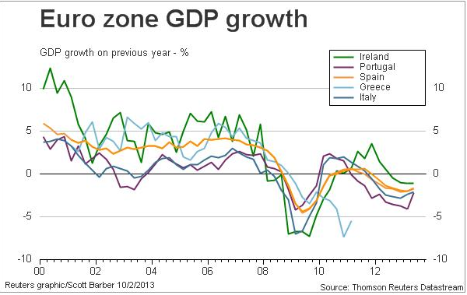
EZ crisis over?
Source: Reuters/Datastream.
Notes:
Greece and Spain stabilizing; there may be a series break for Italy in mid-2010.

Slide 4
Growth returns
Source: IMF WEO, October 2013.
Notes:
Greece and Spain stabilizing; there may be a series break for Italy in mid-2010.

Slide 5
Don’t trust the economists
IMF growth projections and outcomes for the Eurozone
Source: IMF, Dani Rodrik.
Notes:
Greece and Spain stabilizing; there may be a series break for Italy in mid-2010.

Slide 6
Asymmetric Recovery
Industrial Production
Notes:
Greece and Spain stabilizing; there may be a series break for Italy in mid-2010.

Slide 7
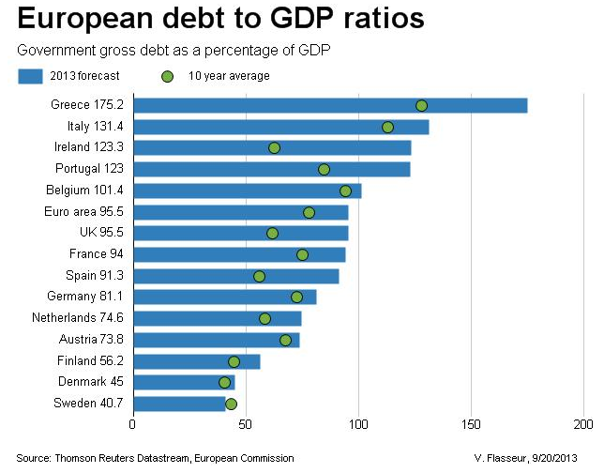
Public debt stock problem
Source: Thomson Reuters Datastream, European Commission.
Notes:
Greece and Spain stabilizing; there may be a series break for Italy in mid-2010.

Slide 8
Private debt stock problem
Private Sector Debt (% of GDP)
 | 2011 | 2012
AT | 161 | 162
BE | 238 | 244
CY | 289 | -
DE | 117 | 118
EE | 133 | -
EL | 130 | -
ES | 222 | 209
FI | 180 | 187
FR | 160 | 167
IE | 308 | 291
IT | 128 | 126
LU | 326 | -
MT | 207 | -
NL | 225 | -
PT | 254 | 259
SI | 129 | 123
SK | 76 | 77
Source: European Commission.
Notes:
Greece and Spain stabilizing; there may be a series break for Italy in mid-2010.

Slide 9
Debt flow problem
Notes:
Greece and Spain stabilizing; there may be a series break for Italy in mid-2010.

Slide 10
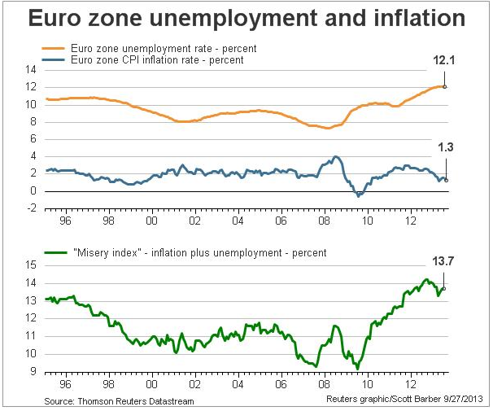
Debt flow problem
Notes:
Greece and Spain stabilizing; there may be a series break for Italy in mid-2010.

Slide 11
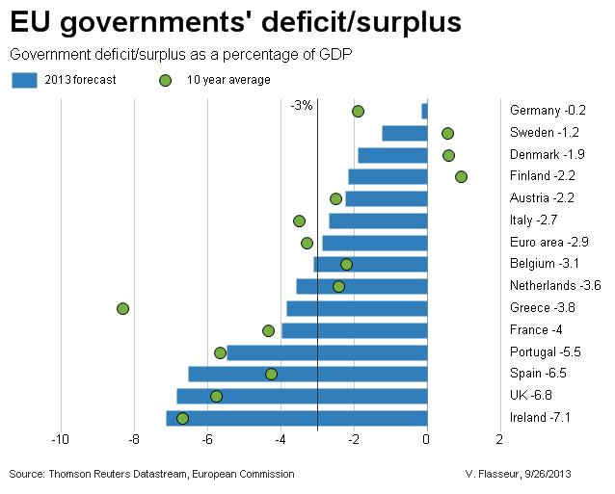
Debt flow problem
Source: Thomson Reuters Datastream, European Commission.
Notes:
Greece and Spain stabilizing; there may be a series break for Italy in mid-2010.

Slide 12
Conditions for companies
SME Borrowing Costs (rates on loans under EUR1m)
Source: ECB.
Notes:
Greece and Spain stabilizing; there may be a series break for Italy in mid-2010.

Slide 13
Ireland and Portugal success stories?
Depends on how you define success
Exit bailout
Finance themselves entirely in the market
Sustainable debt and growth paths
What solutions?
Banking union
Symmetric recovery
Debt work out
Notes:
Greece and Spain stabilizing; there may be a series break for Italy in mid-2010.

Slide 14
Contact details
Megan Greene
Chief Economist
Maverick Intelligence
Email: megan@maverickintelligence.com
Twitter: @economistmeg

